Slide 1
MONEY ADVISER
10TH SEPTEMBER''23
—TEAM EUREKA
-NIR VACHHANI
-KUNAL GADHIA
-RONAK BEDIYA
-JASH LAL

Slide 2
WHAT IS MONEY ADVISER?
—MONEY ADVISER IS A WEB THAT HELPS USER TO CONTROL THEIR FLOW OF MONEY.
— IT SUGGESTES USER BY ANALYSING DATA WHERE TO INVEST IN VAROUS PLATFORMS.
—IT SIMPLE AND EASY TO USE WEB SITE WHICH TAKES DATA ON HOW MUCH USER WANT TO INVEST MONEY
—ON BEHALF OF THAT IT COMPLIES AND PROVIDES THE POSSIBLE OUTCOMES IN THE FORM OF WEBSITES.

Slide 3
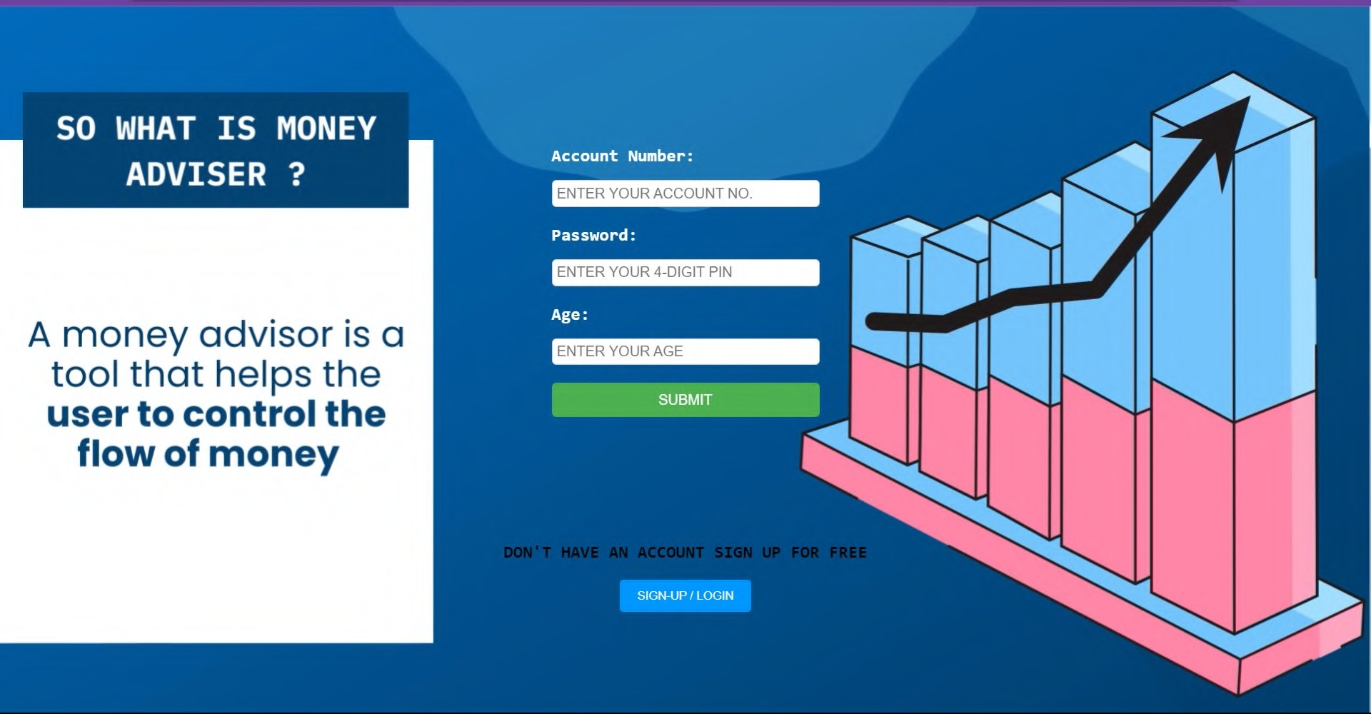
WHAT IS MONEY ADVISER?

Slide 4
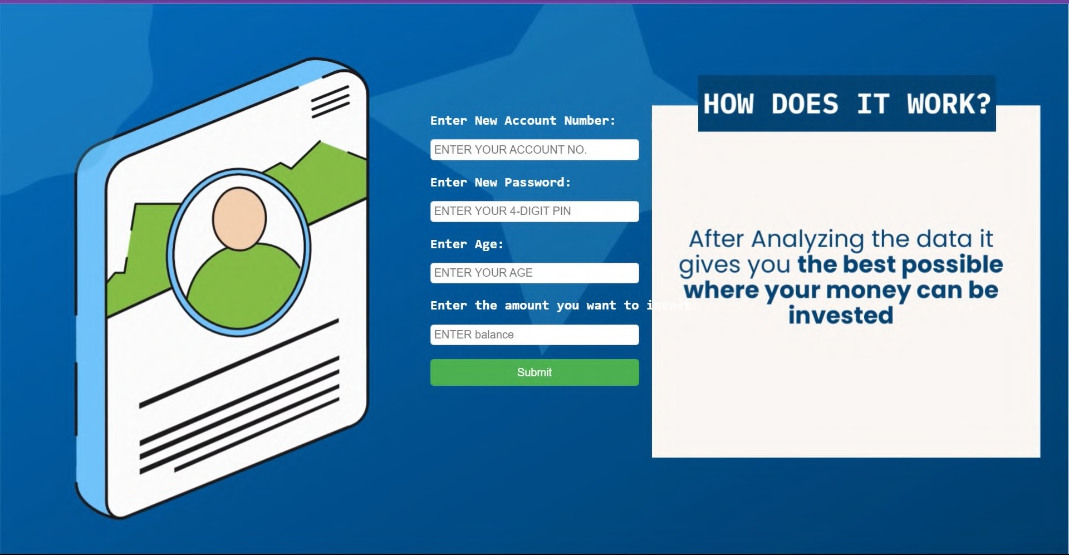
10TH SEPTEMBER''23
WHAT IS MONEY ADVISER ?

Slide 5
SO WHY MONEY
ADVISER ?
10TH SEPTEMBER''23
01

Slide 6
ANSWER
WELL THERE ARE MANY APPLICATION CURRENTLY WORKING ON CRYPTO AND CURRENCY MANAGEMENT SYSTEM
BUT
YOU WILL NOT FIND THIS AT ONE PLACE
MONEY ADVISER DOES IT FOR YOU AT ONE PLACE

Slide 7

so what was the problem you created money advisor for?
The main vision is to balance the economy and maintain it

Slide 8
EVALUATION

Slide 9
EVALUATION
-THE EVALUATION IS TO BE DONE ON THE BASIS OF THE INVESTED AMOUNT
WE HAVE 3 CLUB FOR THE INVESTORS:
SILVER CLUB: which deals with the investor who’s invested amount below 10lakh
GOLDEN CLUB: which deals the investor who’s invested amount is in between 10lakhs to 25 lakh
PLATINUM CLUB: which deals the investor who’s invested amount is above 50lakh
0

Slide 10


Slide 11


Slide 12


Slide 13
reads the amount of balance and suggest many ideas to invest the answers can be short and simple succinct.

Slide 14
THANK YOU
—TEAM EUREKA

